Slide 1

Ship Detection Based on Faster R-CNN Using Range-Compressed Airborne Radar Data
A presentation of TECHCRAFT EXPO.
under
BACHELOR OF TECHNOLOGY
In
INFORMATION TECHNOLOGY
By
SYEDA SUMMAYYA FIRDOUS 20L51A1242
SHAISTA ERAM 20L51A1230
HALEEMA SADIYA 20L51A1213
Department of Information Technology
Shadan Women’s College of Engineering and Technology, Khairatabad,
Hyderabad-500 004
2023-2024

Slide 2
contents
Abstract
Introduction​
Literature
​ Description
Conclusion
Existing system of R-CNN
Working of R-CNN
Architecture of R-CNN
Proposed method

Slide 3
Abstract
This research presents a novel approach for ship detection leveraging the Faster R-CNN (Region-based Convolutional Neural Network) framework applied to range-compressed airborne radar data.
The integration of deep learning techniques with radar data offers an efficient and automated solution for identifying and locating maritime vessels in diverse environmental conditions.
The proposed system harnesses the advantages of Faster R-CNN, incorporating a Region Proposal Network (RPN) for bounding box generation and a Fast R-CNN detector for accurate ship classification.

Slide 4
Introduction
Ship Detection:
The primary goal is to identify the presence and location of ships within a given scene or image.
Faster R-CNN:
Faster R-CNN is a deep-learning framework for object detection. It is an extension of the original R-CNN (Region-based Convolutional Neural Network) and improves its speed.
Range-Compressed Airborne Radar Data:
Range compression is a technique used in radar signal processing to enhance the target range resolution.
Airborne radar data suggests that the radar is mounted on an airborne platform (such as an aircraft or drone) and collects data from an elevated position.
Integration of Faster R-CNN with Radar Data:
The Faster R-CNN algorithm is adapted or designed to work with radar data, specifically range-compressed airborne radar data.
The radar data likely provides information about the distance to the targets (ships), and the Faster R-CNN model is trained to analyze and detect ships based on this radar data.

Slide 5
Literature
Title | author | year | method | parameters
1. Ship Detection Based on Faster R-CNN Using Range-Compressed Airborne Radar Data | Tamara loran, Sushil Kumar, Gerhard Krieger | 2023 | Faster R-CNN with different backbones, Constant False Alarm Rate (CFAR) | Robustness Metrics, Real-world Applicability
2. The High-Resolution Digital-Beamforming Airborne SAR System DBFSAR | Andreas Reigber * , Eric Schreiber, Kurt Trappschuh, Sebastian Pasch, Gerhard Müller, Daniel Kirchner & co. | 2020 | SAR Image Formation Algorithms, Interferometric SAR (InSAR) Algorithms | Accuracy Metrics, Efficiency Metrics
3. Ship Classification in SAR Images Using a New Hybrid CNN–MLP Classifier | Forough Sharifzade, Gholamreza Akbari Zadeh, Yousef Seifi Kavian | 2018 | Multi-layer perception, (MLP), Convolutional neural network | Better performance, accuracy metrics
4. A Tutorial on Synthetic Aperture Radar | Alberto Moreira, Pau Prats-Iraola, Marwan Younis, Gerhard Krieger | 2013 | Range Compression Algorithm, Doppler Processing Algorithm | Range Resolution, Doppler Frequency
5. Satellite Imaging for Maritime Surveillance of the European Seas | Harm Greidanus | 2008 | Synthetic Aperture Radar (SAR) Detection, | Speed and Computational Efficiency, Robustness

Slide 6
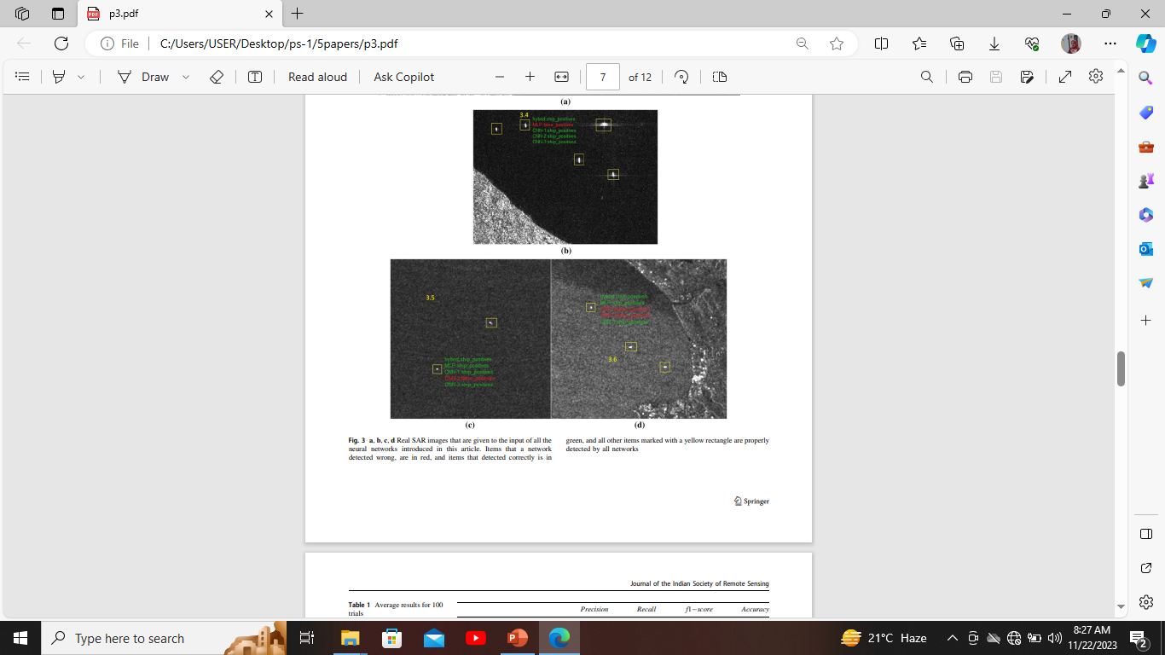
description
paper-1 Research by: Shaista Eram [20L51A1230]
TITLE: Ship Classification in SAR Images Using a New Hybrid CNN–MLP Classifier
AUTHOR: Foroogh Sharif Zadeh, Gholamreza Akbari Zadeh, Yousef Seifi Kavian
YEAR: 2018
BRIEF:
Ship classification in synthetic aperture radar (SAR) images is a challenging task that involves the use of advanced techniques to extract relevant features and make accurate predictions. The combination of Convolutional Neural Networks (CNNs) and Multilayer Perceptron's (MLPs) in a hybrid model can enhance the classification performance by leveraging the strengths of both architectures.

Slide 7
METHODS/ALGORITHMS:
The algorithms used in ship classification in SAR images using a new hybrid CNN-MLP classifier are
MULTILAYER PERCEPTRON (MLP):
Multilayer Perceptrons (MLPs) are a type of artificial neural network commonly used in machine learning tasks, including image classification. Ship classification in Synthetic Aperture Radar (SAR) images is a significant application, as SAR provides unique advantages such as all-weather, day-and-night imaging capabilities.
2. CONVOLUTIONAL NEURAL NETWORK (CNN):
Ship classification in synthetic aperture radar (SAR) images using Convolutional Neural Networks (CNNs) involves leveraging the power of deep learning to automatically learn hierarchical features from the input data. SAR images are particularly challenging due to their complex and noisy nature, making traditional image processing methods

Slide 8
PARAMETERS:
BETTER PERFORMANCE:
This program analyzes the image pixel by pixel, identifying the targeted pixels by analyzing the statistical data of its neighboring pixels. Then, for picture classification, a neural network using a hybrid CNN and multilayer perceptron method (CNN–MLP) is recommended. This approach uses genuine SAR photos from Sentinel-1 and RADARSAT-2 satellites to train the algorithm, which results in a better performance compared to state-of-the-art in object classification.
2. ACCURACY:
Accuracy is a fundamental metric that measures the overall correctness of the classification model. It is the ratio of correctly predicted instances to the total instances.

Slide 9
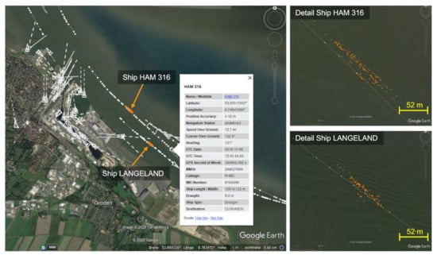
paper-2 Research by: HALEEMA SADIYA [20L51A1213]
TITLE: : The High-Resolution Digital-Beamforming Airborne SAR System DBFSAR
AUTHOR NAME : Andreas Rieger, Eric Schreiber, Kurt Trapp schuh
YEAR : 2020
BRIEF:
Synthetic Aperture Radar (SAR) system with digital beam forming (DBF) capabilities, known as the DBFSAR, being developed by the Microwaves and Radar Institute of the German Aerospace Centre (DLR). SAR is a remote sensing technique used for high-resolution Earth surface imagery. The limitation of current space-borne SAR systems is their challenge in achieving both high azimuth resolution and a large swath width simultaneously.

Slide 10
METHODS / ALGORITHMS:
The algorithms used in high resolution digital beamforming airborne Sar system are:
1.Synthetic Aperture Radar:
SAR algorithms are used to process the raw radar data obtained from the antenna.
Range Doppler processing is a fundamental step, which involves range compression and Doppler processing to generate SAR images.
Motion compensation algorithms are employed to correct for the platform's movement during data acquisition.
2. Digital Beamforming :
DBF is a technique that involves using multiple antenna elements to form and steer the radar beam digitally.
Beamforming algorithms are employed to combine signals from different antennas with appropriate weights to achieve the desired beam shape and direction.
Adaptive beamforming techniques may be used to mitigate interference and improve the signal-to-noise ratio.

Slide 11
PARAMETERS:
1.Scale and robustness:
Test the algorithms on a variety of DBFSAR images with different resolutions, lighting conditions, and environmental factors to assess their robustness.
2. Detection and accuracy:
The ratio of correctly detected ships to the total number of actual ships.
The ratio of incorrectly detected ships to the total number of actual non-ships.

Slide 12
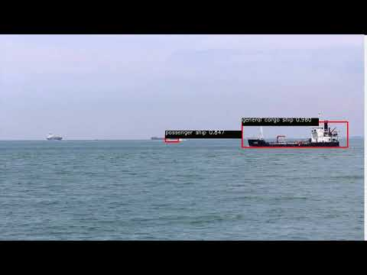
paper-3 Research by: syeda summayya firdous [20L51A1242]
Title: Ship Detection Based on Faster R-CNN Using Range-Compressed Airborne Radar Data
AUTHOR:
Tamara Loran, Sushil Kumar Joshi, Member, Stefan V. Baumgartner, and Gerhard Krieger YEAR: 2023
BRIEF:
Detecting ships using Faster R-CNN (Region-based Convolutional Neural Network) can be a powerful approach for robust ship detection in images. Faster R-CNN is a popular object detection algorithm that uses a region proposal network (RPN) to generate candidate object regions, which are then classified and refined.

Slide 13
METHODS/ALGORITHMS:
FASTER R-CNN WITH DIFFERENT BACKBONES:
Experimenting with different backbone architectures, such as EfficientNet, ResNeXt, or Mobile Net, can impact the trade-off between accuracy and speed. EfficientNet, for instance, is known for its efficiency in terms of parameters and computation.
2. CFAR:
Constant False Alarm Rate (CFAR) is a technique used to detect targets in radar data by maintaining a constant false alarm rate. It distinguishes between the statistical properties of noise and potential target signals.

Slide 14
PARAMETERS:
Robustness Metrics:
Performance under Adverse Conditions: Evaluate how well the algorithm performs under challenging conditions, such as adverse weather, low lighting, or occlusions.
Generalization to Different Datasets: Test the algorithm on diverse datasets to assess its ability to generalize to different environments.
2. Real-world Applicability:
Performance in Real-world Scenarios: Evaluate the algorithm's performance in a realistic maritime environment, considering factors such as ship density, varying scales, and complex backgrounds.

Slide 15
conclusion
The analyzed statement after the detailed study of these three papers is that we would like to proceed with this project by proposing the method i.e. RCNN to prove its capability in this area of research as the accuracy robustness and efficiency of this method is considered to be most efficient compared to the other methods/algorithms.
PROPOSED METHOD:
R-CNN
MATCHED PARAMETER:
The robustness of the ship during the detection
Accuracy
Efficiency

Slide 16
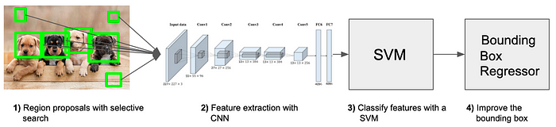
EXISTING SYSTEM OF R-CNN
Region-based Convolutional Neural Networks (R-CNN) represent a pivotal advancement in the field of object detection. Introduced by Ross Girshick and his colleagues in 2014, R-CNN combines the power of convolutional neural networks (CNNs) with region proposal methods to accurately locate and classify objects within an image.
The system operates in two main stages: first, it generates a set of region proposals using a selective search algorithm, which identifies potential object locations. Subsequently, each proposed region is individually processed by a CNN to extract features, and a support vector machine (SVM) is employed for classification.
Finally, bounding box regression is applied to refine the localization accuracy. Although effective, R-CNN has faced criticisms for its computational inefficiency during training due to the need to independently process each region proposal.

Slide 17
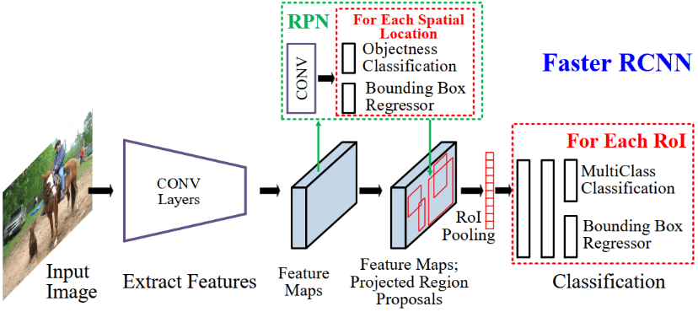
Despite these challenges, R-CNN has laid the foundation for subsequent improvements, such as Fast R-CNN and Faster R-CNN, which aim to enhance speed and efficiency in object detection tasks.
WORKING OF R-CNN:

Slide 18
ARCHITECHTURE OF R-CNN
Region-based Convolutional Neural Network (R-CNN) is a pioneering architecture in the field of object detection, designed to address the limitations of traditional methods.
The R-CNN system consists of several key components that work cohesively to identify and localize objects within an image. The process begins with selective search, a region proposal algorithm that generates a diverse set of potential object bounding boxes.
These proposals serve as input to a pre-trained convolutional neural network (CNN), typically based on architectures like AlexNet or VGG, which extracts feature maps from each region.
The features are then fed into support vector machines (SVMs) to classify the proposed regions into different object classes. Simultaneously, bounding box regresses refine the coordinates of the bounding boxes to improve localization accuracy.

Slide 19
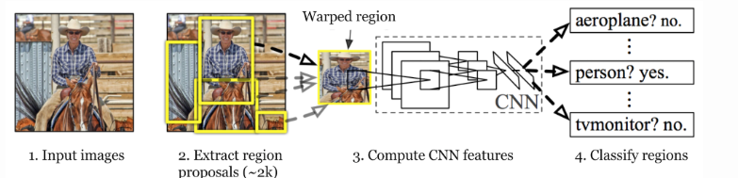
R-CNN ARCHITECTURE
However, R-CNN has drawbacks in terms of computational inefficiency, as it processes each region independently. To address this, subsequent variations like Fast R-CNN and Faster R-CNN have been introduced, leveraging improvements such as shared convolutional features and introducing region proposal networks (RPNs) to streamline the process and enhance overall efficiency in object detection.

Slide 20
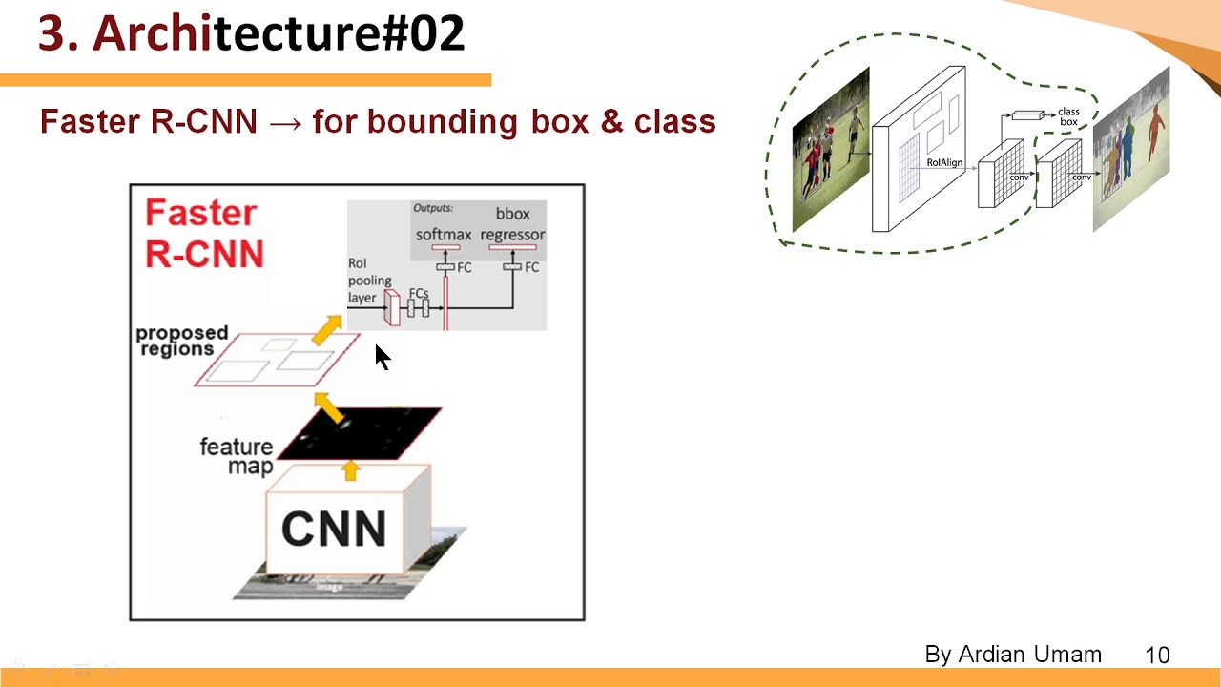
The proposed method: R-cnn
INPUT:
Image: the input to the R-CNN is an image containing objects of interest (e.g., ships in the case of ship detection).
REGION PROPOSAL:
Selective search: in the first step the algorithm generates a set of region proposals that are likely to contain objects. Selective search is a common method for this purpose.

Slide 21
THANK YOU

